Slide 1
Introduction to Computer Systems
Praveen Garimella
Orientation on Feb 13, 2016
Course offered to MSIT Co2017

Slide 2
Outline
Tour of ICS
Tasks & Capstone Project
Exams
ICS Course Calendar
Evaluation Procedures
Communication for QnA
Know your Mentors and Teaching Assistants

Slide 3
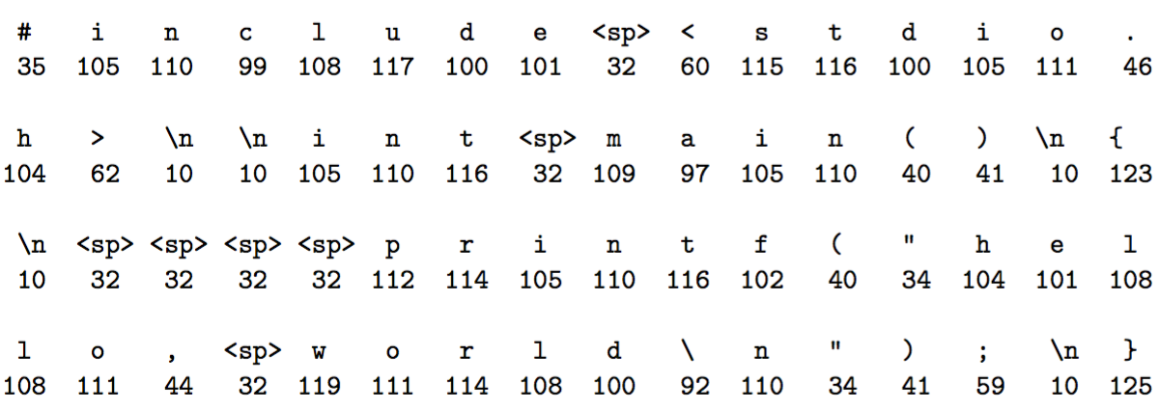
Guess what?

Slide 4
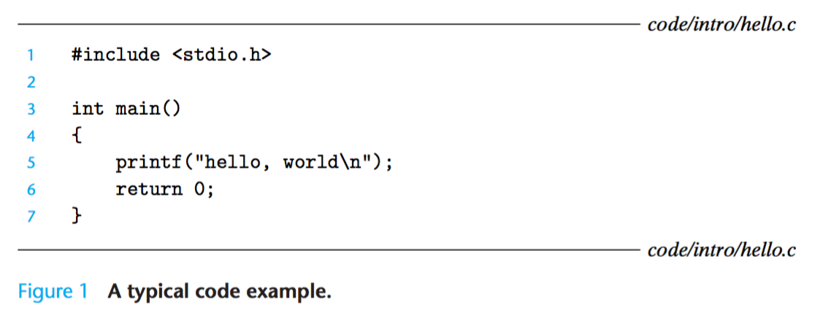
Hello World

Slide 5
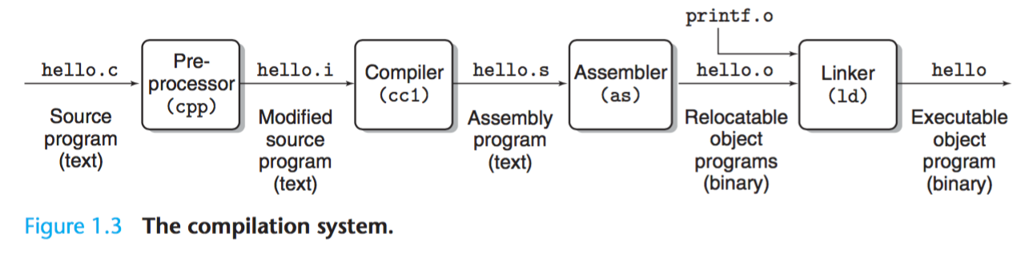
Compilation System

Slide 6
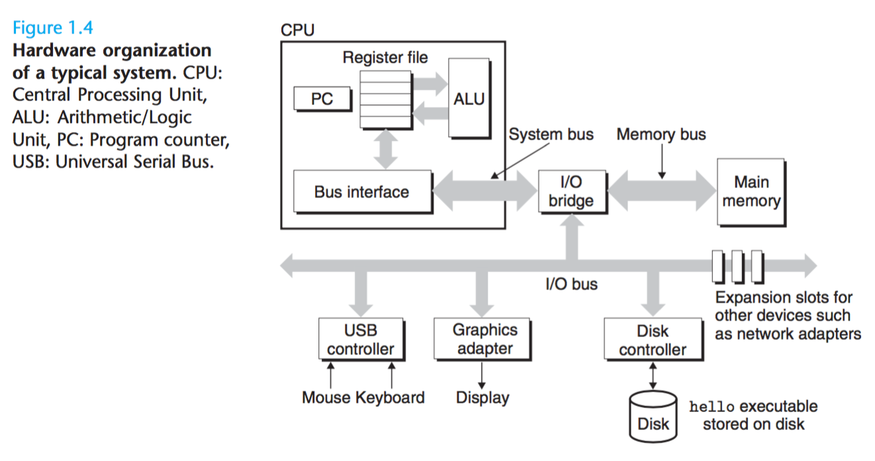
Hardware Organisation

Slide 7
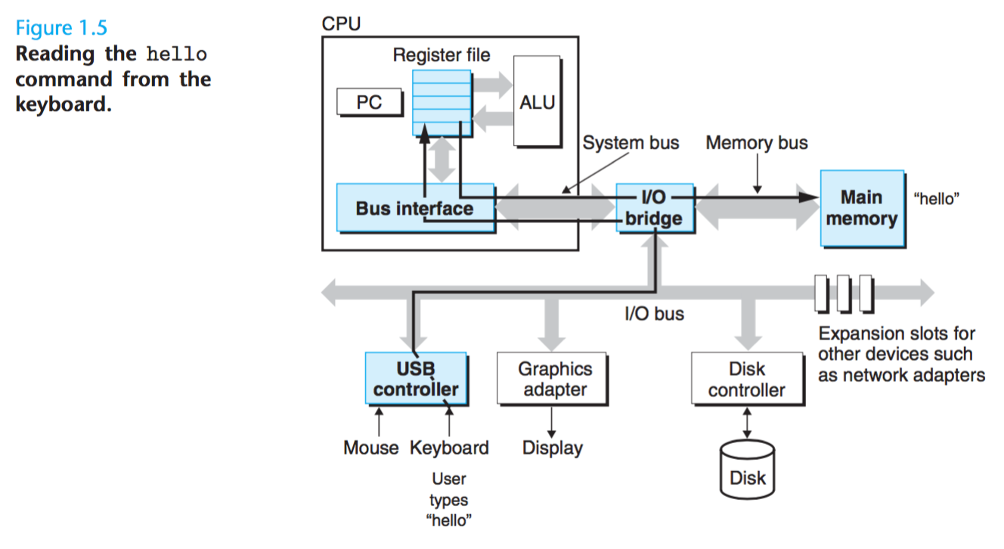
Typing hello command

Slide 8
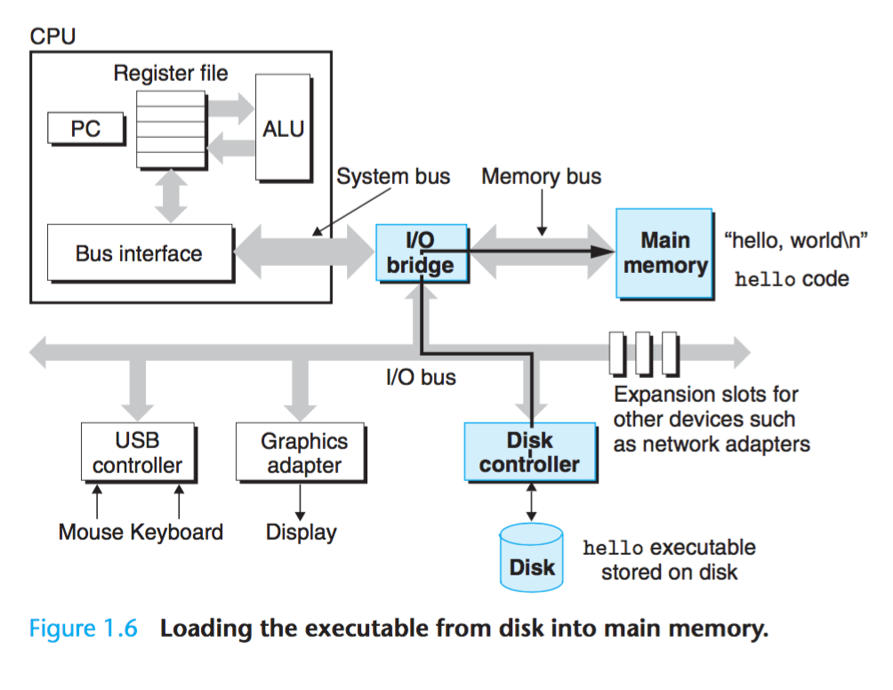
Load hello exe into memory

Slide 9
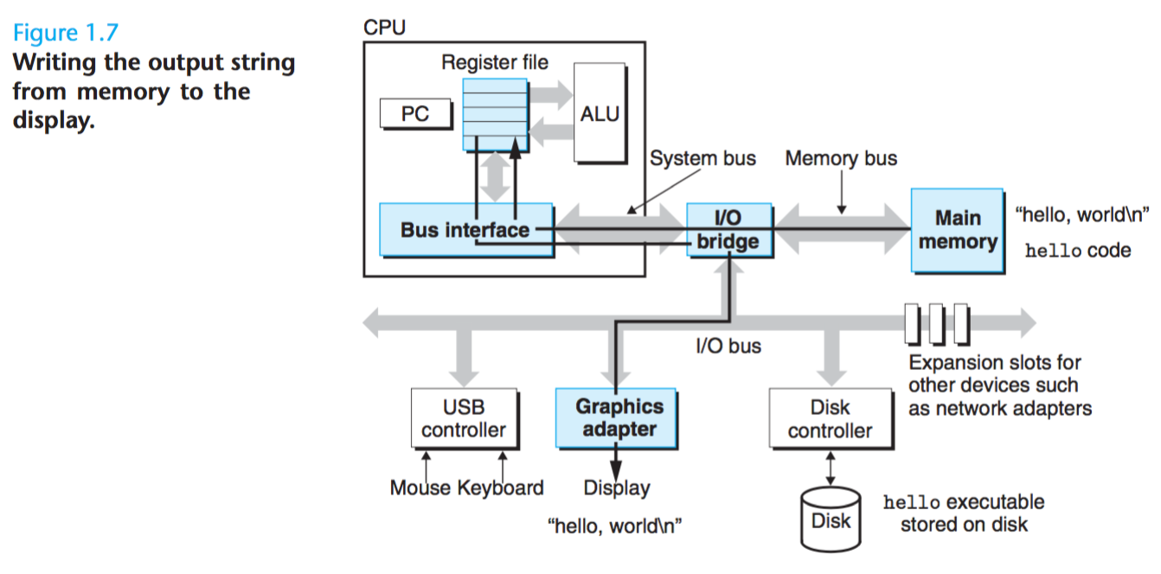
Output string from memory to display

Slide 10
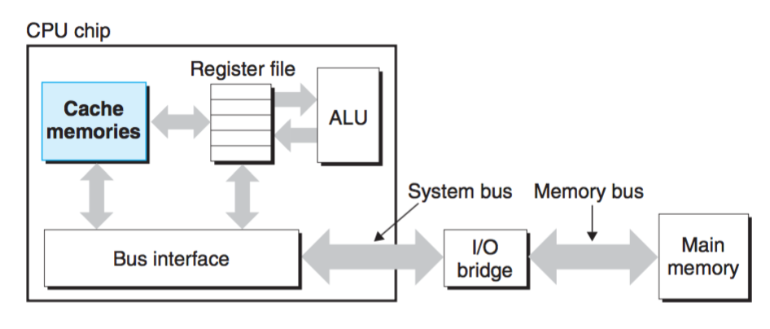
Cache Memories

Slide 11
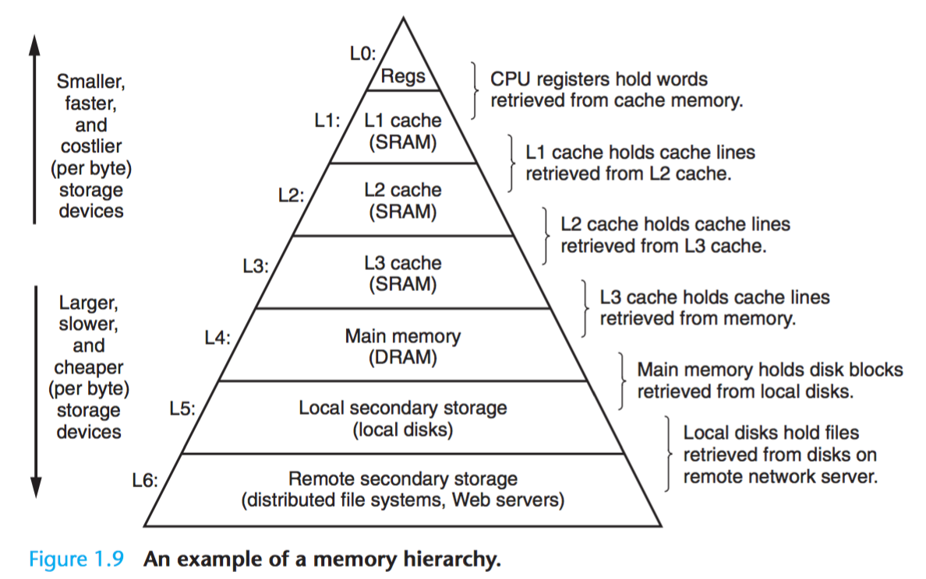
Memory Hierarchy

Slide 12
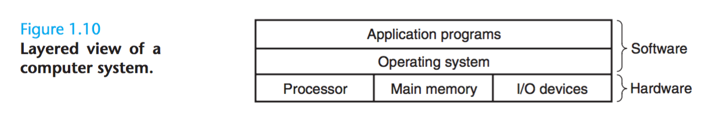
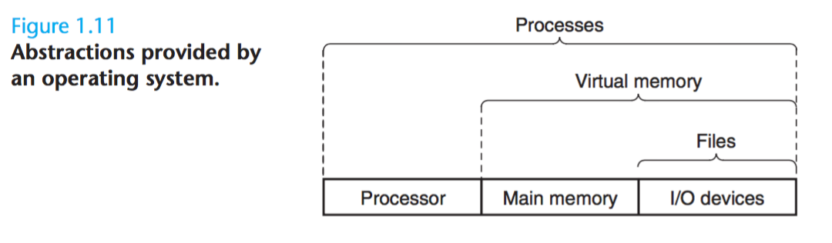
Operating System

Slide 13
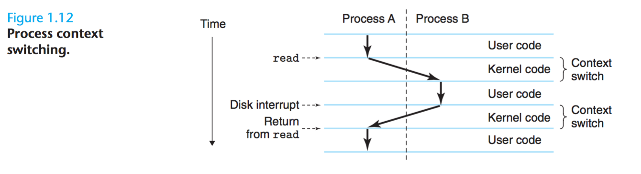
Processes

Slide 14
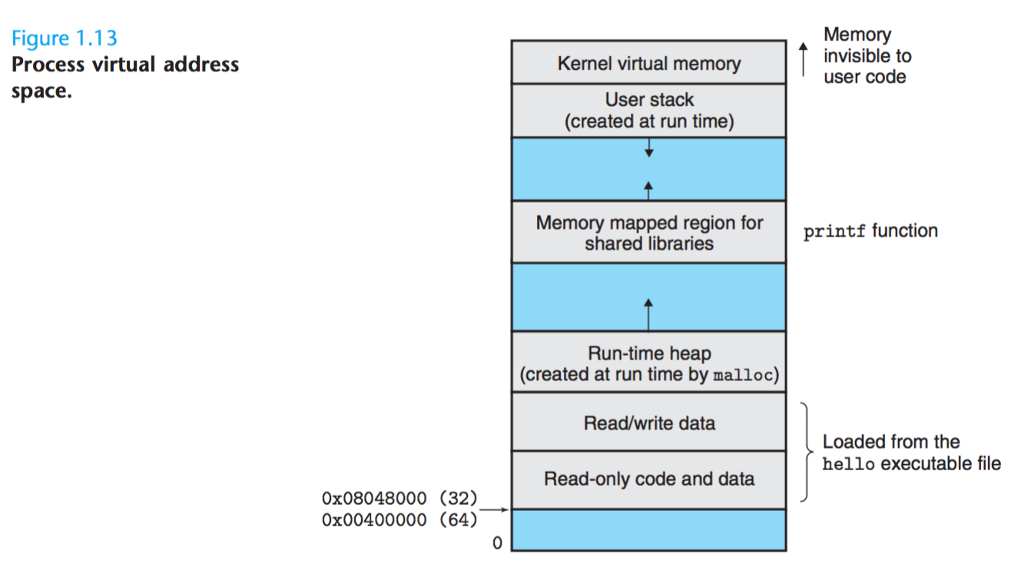
Virtual Memory

Slide 15
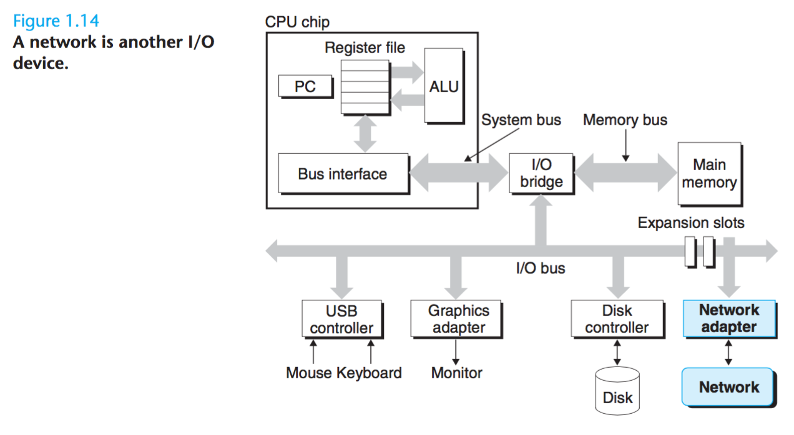
Network I/O

Slide 16
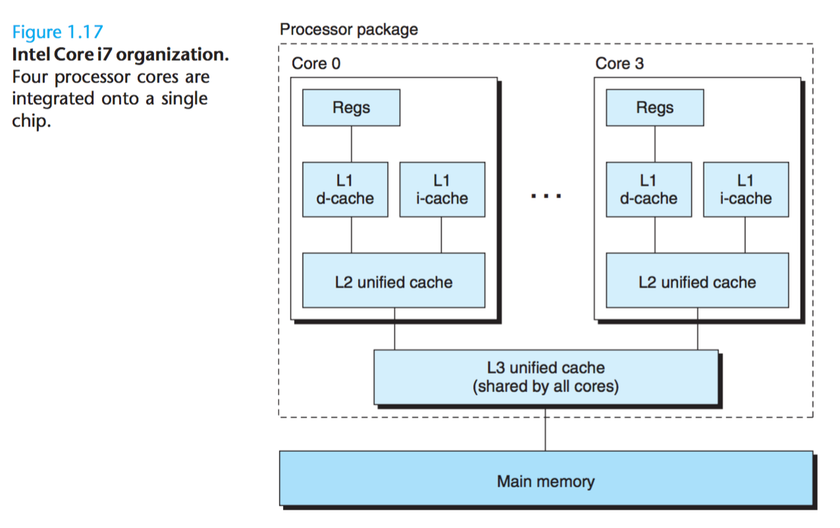
Core i7

Slide 17
Tasks & Capstone Project
Data Lab
Understand the bit-level representations of C data types and the bit-level behaviour of the operations on data
Bomb Lab
Understand assembly language, and also forces them to learn how to use a debugger
Attack Lab
About the stack discipline and teaches them about the danger of writing code that is vulnerable to buffer overflow attacks
Cache Lab
Optimise a small matrix transpose kernel to minimise the number of misses on a simulated cache
Shell Lab
Application level concurrency, Unix process control, signals, and signal handling
Malloc Lab
Really understand pointers!

Slide 18
Exams
Mid 1 - Dates TBD
Mid 2 - Dates TBD
Final Exam - Dates TBD

Slide 19
Week 1 - Calendar
Monday
Linux Installations
Tour of Computer Systems - Textbook Reading
Tuesday
Discussion on Tour of Computer Systems
Linux Bootcamp I
Textbook Reading on Information Storage and Practice Problems
Wednesday
Discussion on Data Representation
Linux Bootcamp II
Textbook Reading on Integer Representation and Practice Problems

Slide 20
Week 1 - Calendar
Thursday
Discussion on Integer Representation
Data lab
Textbook Reading on Integer Arithmetic and Practice Problems
Friday
Data lab
Saturday
Bomb lab orientation

Slide 21
Evaluation Procedures
Totally there will be 3 Concept Tests and 3 Problem Solvings.
First and Second exam will be having 30% weightage.
The last having 40% weightage
Home Work Problems and Summary will be having 50% and Labs will be having 50% weightage.

Slide 22
Mentors and Teaching Assistants
Dr. Mohammad Abdul Wajeed.
N.D.V. Siva Sankar. (Course Impl. Incharge).
V. Lakshmi Kanth.
Shahi Rehana Begum.
E. Tejaswini.
Sai Raghu Teja.
Sreenath.
Sameera and Rajeev.
Sharath Chandra and Jayanth.
Navya and Manasa
Poonam and Pavani.

Slide 23
Absent Policy.
If you are late, you will be charged a fine of Rs. 100.
You are not allowed to take more than 3 leaves.
You need to take a prior intimation from your mentor regarding your leave.

